Slide 1
DLHLP - HW3
Source Separation
TA: 黃冠博、陳泓廷、楊采綸
dlhlp.ta@gmail.com

Slide 2
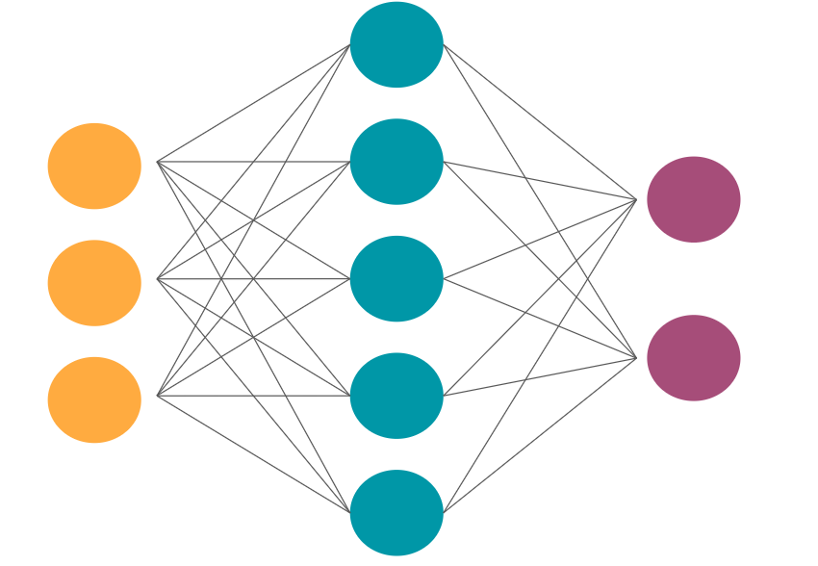

Source separation
mixture of two people speaking
Notes:
這次作業的目標是將兩個speaker的聲音分出來
其中分成兩個小部分，3-1是speaker dependent的，也就是說全部的語者只有兩個人
而3-2是independent，這時候就會需要PIT去解決output順序的問題

Slide 3
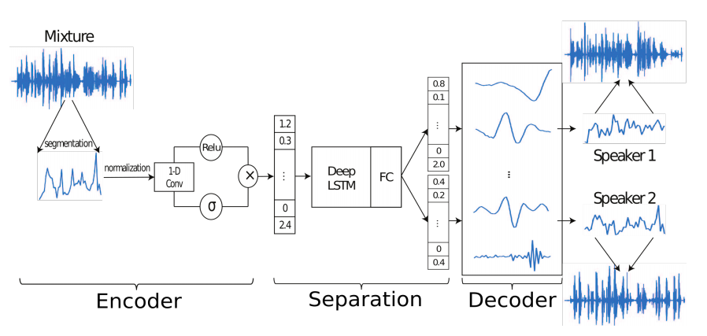
Time-domain audio separation network (TasNet)
Notes:
tasnet是一個time domain的source separation model，也就是說他的input不是Spectrogram 而是Mixture raw waveform signal
TasNet主要架構有兩種，起初是使用BLSTM作為主體，但礙於LSTM的特性Time step時間步數過長，導致模型參數規模及訓練時間長久

Slide 4
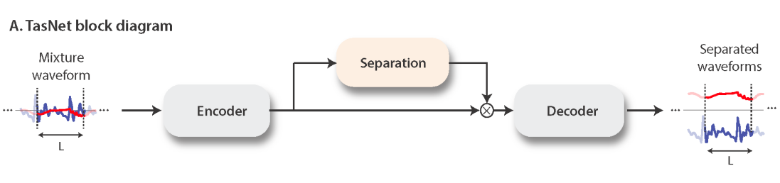
Conv-TasNet
Notes:
the use of a deep long short-term memory (LSTM) network as the separation module in the original TasNet significantly limited its applicability.
conv-tasnet分為encoder separation和decoder三個部分

Slide 5
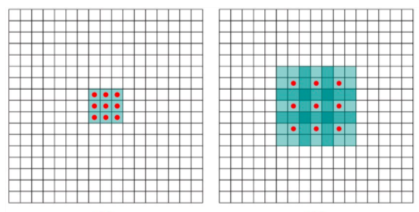
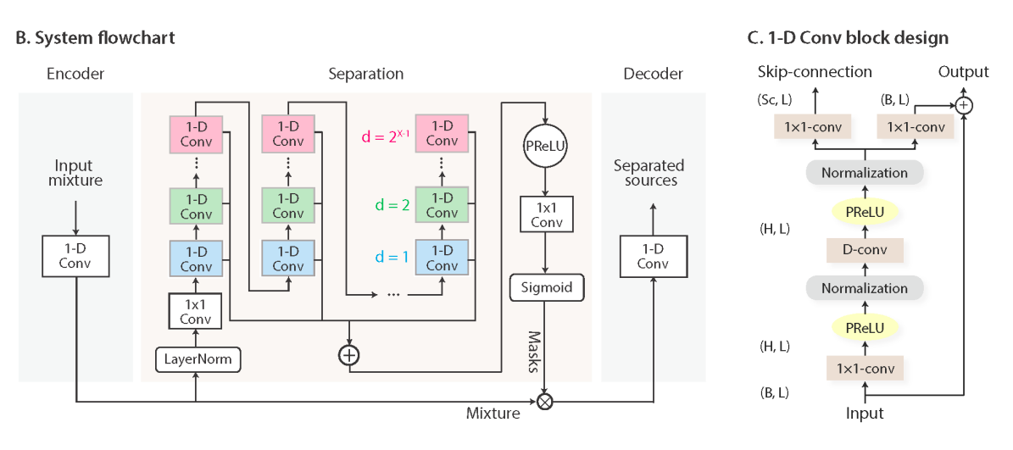
Conv-TasNet
Notes:
Encoder 透過 conv1D 的特性，類似於將原始raw waveform進行Fourier Transform得到我們要的feature
Decoder 則是在做de convolution，將中間層的東西還原成聲音訊號
conv-block的架構如右圖，是幾層Convolution、activate function及Normalization layer
conv-block是dilated的，好處是不做pooling損失信息的情況下，加大了感受野，讓每個卷積輸出都包含較大範圍的信息。在語音文本需要較長的sequence信息依賴比較好
D-convolution 則是 depth-wise convolution，縮減整個模型所需的參數 從GxPxH 變成 GxP+GxH

Slide 6

Problem
mixture of two people speaking

Slide 7
Problem
mixture of two people speaking

Slide 8
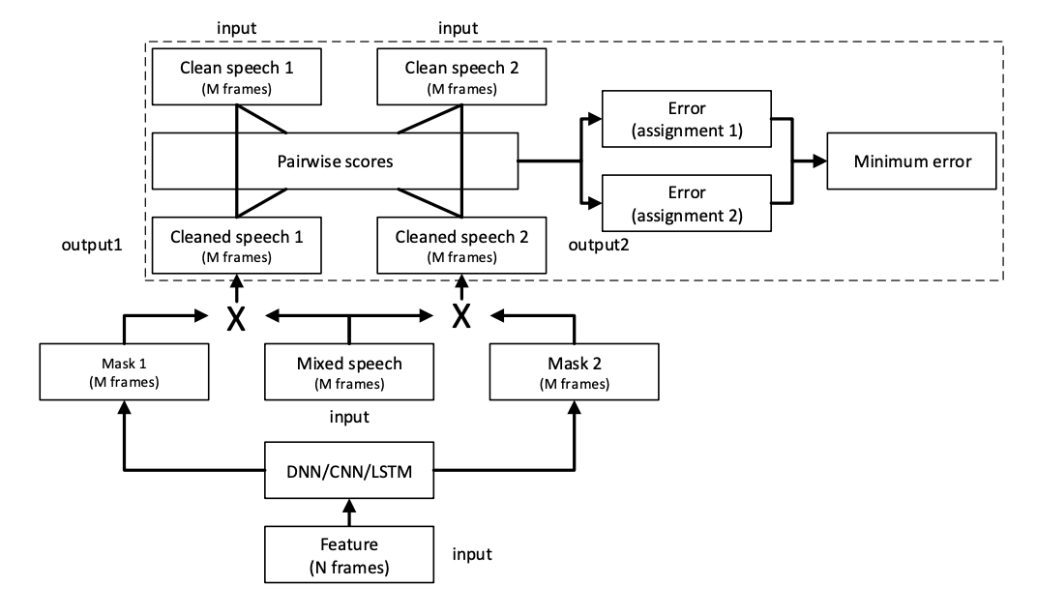
Permutation Invariant Training (PIT)
speech 2
(ground truth)
speech 1
(ground truth)
speech 1
(ground truth)
speech 2
(ground truth)
MSE
MSE
output 1
output 2
https://arxiv.org/pdf/1607.00325.pdf
Notes:
同樣的mixture input，model產出兩段語音，這兩段語音誰是speaker 1誰是speaker 2呢？

Slide 9
Requirements
Run the two following tasks:
3-1 speaker dependent
only two speakers
training data and testing data are the same two speakers
3-2 speaker independent
many different speakers
the speaker set in training data and testing data do not overlap
Notes:
data: WSJ0-mix 2 speaker

Slide 10
Dataset
3-1 (2 GB) only two speakers
https://drive.google.com/open?id=1thV_9B1Noyf2Q91FTVJwGrS-Xh0BjqFT
gdown https://drive.google.com/uc?id=1thV_9B1Noyf2Q91FTVJwGrS-Xh0BjqFT
3-2 (5.7 GB) many speakers
https://drive.google.com/file/d/1g3ObZnCNtdYMLYe-YNwbjkMlUrFszjxY/view?usp=sharing
gdown https://drive.google.com/uc?id=1g3ObZnCNtdYMLYe-YNwbjkMlUrFszjxY
1.Download from google drive or
2.Use gdown command in the command line
(pip install gdown if not installed)

Slide 11
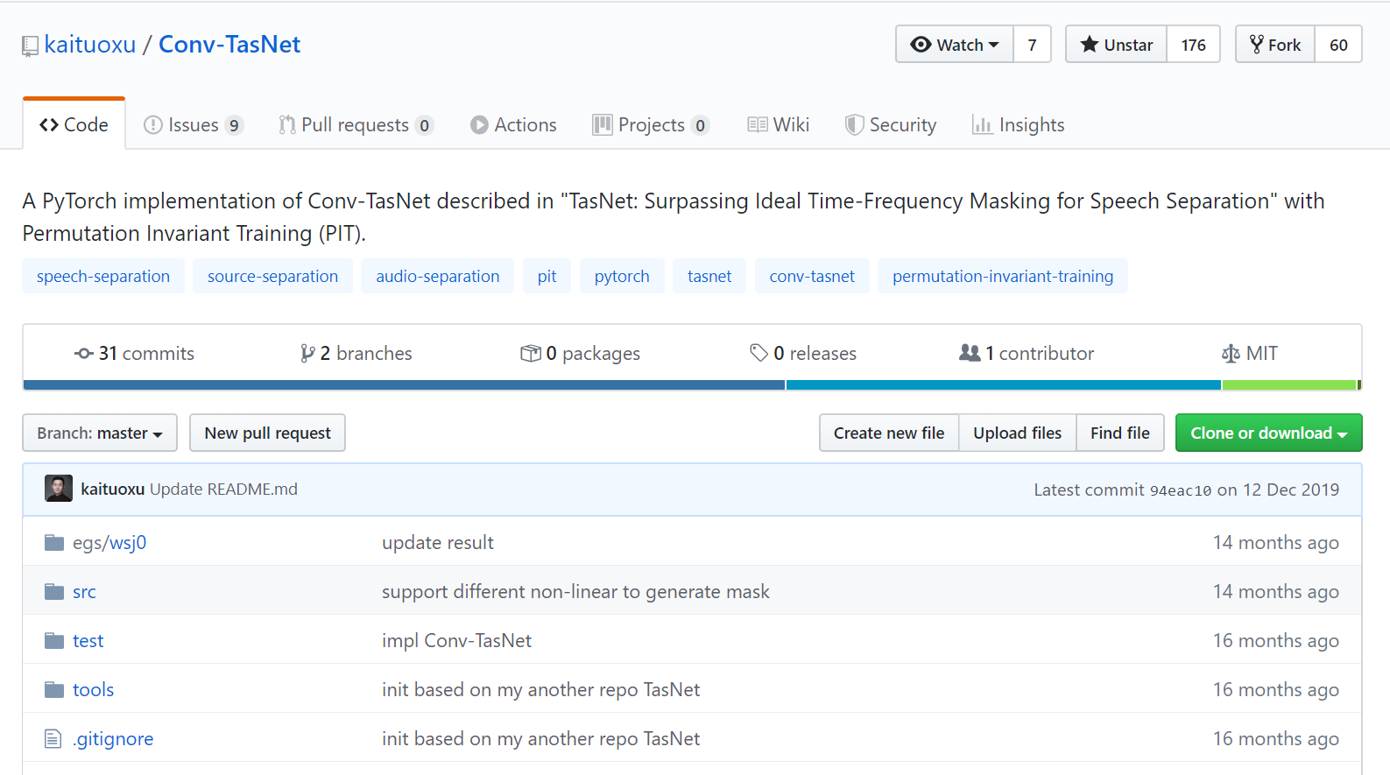
Implementation - Conv Tasnet
[Link]

Slide 12
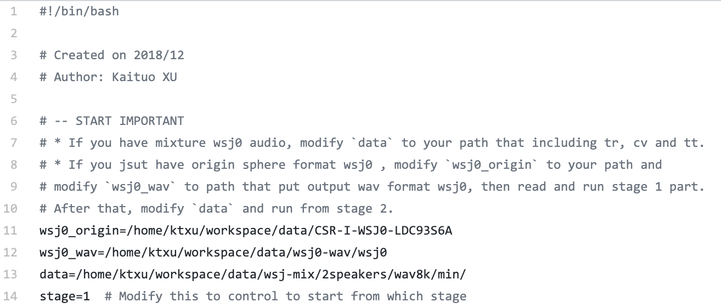
Run
egs/wsj0/run.sh
don’t care about these two paths
make sure you modify this path(data) to the path where min/ is located

Slide 13
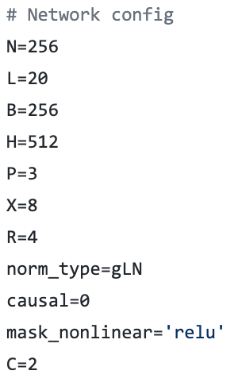
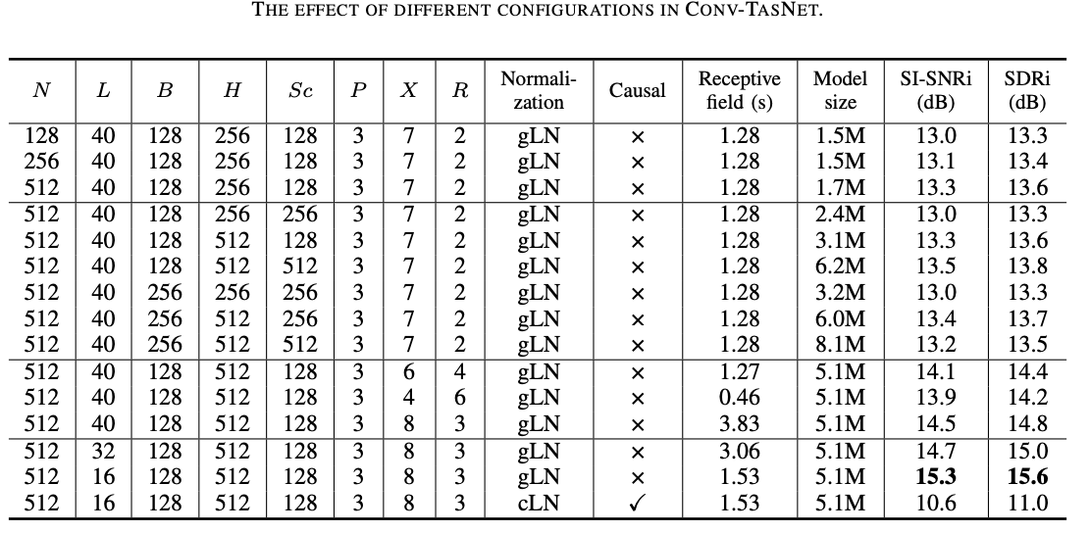
Network Configuration
Feel free to change the configuration by yourself.
Larger model size results in longer training time.
egs/wsj0/run.sh

Slide 14
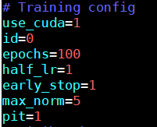
PIT?
egs/wsj0/run.sh
change pit to 0 to disable PIT

Slide 15
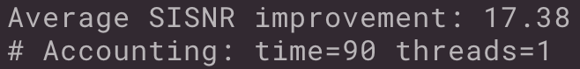
Submit testing result
for example: in the following directory “Conv-TasNet/egs/wsj0/exp/train_r8000_N256_L20_B256_H512_P3_X8_R4_C2_gLN_causal0_relu_epoch100_half1_norm5_bs3_worker4_adam_lr1e-3_mmt0_l20_tr/”
zip separate/ and push it to your github repository (should be less than 100MB)
hw3/results/3-1/separate.zip
hw3/results/3-2/separate.zip
hw3/results/bonus/separate.zip (optional)
in evaluate.log, report average SISNR
report.pdf
do not push separate/ to github without zipping !
Notes:
這裡的Si-SNR = Si-SDR 請不要謊報Si-SNR，助教這裡可以測你的separation.zip裡面的average Si-SNR

Slide 16
Report(1/2)
[Template]
(5%)請記錄 evaluate.log 裡面的SiSNR 數值，和當時所用的hyperparameter(這一題請3-1不用PIT, 3-2用PIT)
(5%)嘗試調整不同的hyperparameter，比較其差異，並試著分析結果
(至少針對2種不同的hyperparameter進行實驗)
(3%)3-1, 3-2請分別試看看有無PIT的差異並記錄結果 (loss learning curve, Si-SNR)
(2%)思考一下為何有無PIT會影響3-1, 3-2的結果並寫下你的看法
Your best model should pass the baseline! Si-SNR = 10
NOTE: 第一題請回報最後上傳Github的separation.zip的Si-SNR數值
Notes:
第一題記錄參數請記錄投影片P13的黑色框框裡面的那幾個，分別是N, L, B, H, P, X, R, norm_type, causal, mask_nonlinear, C baseline基本上用很小的model都會過，建議不要用到paper上模型較大的設置，會訓練很久
bonus提示：可以用看看老師上課講的deep clustering 當然，如果你有辦法能直接improve Conv TasNet的performance也可以XD ------------------------------------------- 目前其他做source separation也做得很好的paper： wavesplit https://arxiv.org/pdf/2002.08933.pdf dual path rnn https://arxiv.org/pdf/1910.06379.pdf

Slide 17
Report(2/2)
有用tasnet分離得到一個sisnr分數，improve後再分離得到更好的sisnr，並於report說明方法 ->2分
有用tasnet分離得到一個sisnr分數，只有提出方法 -> 0.5~1分
有用tasnet分離得到一個sisnr分數 沒有講關於improve的東西 -> 0分
[Template]
bonus(2%) : 請自己找兩段音訊合起來(請不要使用作業給的data)測看看是否能成功分離，
上傳音訊(含原音檔、合成後音檔及經過model分離的音檔)，紀錄Si-SNR於report中，並給出至少一種improve Si-SNR的方法(調參數除外)。
將bonus結果放在hw3/results/bonus/separate.zip，裡面除了分離後的音檔，請另外創建資料夾”origin”，放進你的原音檔（s1, s2, mix）
separate/
s1.wav, s2.wav
origin/
s1.wav, s2.wav, mix.wav
Notes:
bonus提示：可以用看看老師上課講的deep clustering 當然，如果你有辦法能直接improve Conv TasNet的performance也可以XD ------------------------------------------- 目前其他做source separation也做得很好的paper： wavesplit https://arxiv.org/pdf/2002.08933.pdf dual path rnn https://arxiv.org/pdf/1910.06379.pdf

Slide 18
Reference
Paper - TasNet
Paper - Conv-TasNet
Source code - Conv-TasNet implemented by kaituoxu (forked)

Slide 19
Deadline
2020/05/06 9:00

